Slide 1
Weekly Chats with Global IT
“DevOps Overview” with Naveen Jogi
Tuesday, February 20, 2018

Slide 2
Agenda for Today’s Chat
Opening Remarks & Announcements
Olympics have begun – Go for GOLD! Join the Yammer group
Suhas Yerra’s town hall Wednesday Feb 21 from 8-9pm EST or Thursday Feb 22 from 9-10am EST
Want to ask a question?
Use Yammer, the SharePoint, or Chat within WebEx to let us know you have a question
REMINDER: We are recording the presentation, please make sure to mute unless you are asking a question during the Q&A

Slide 3

Feb 2018
NextGen DevOps
Presented For:
Prepared By:
NextGen IT
General Insurance DevOps Engineering

Slide 4
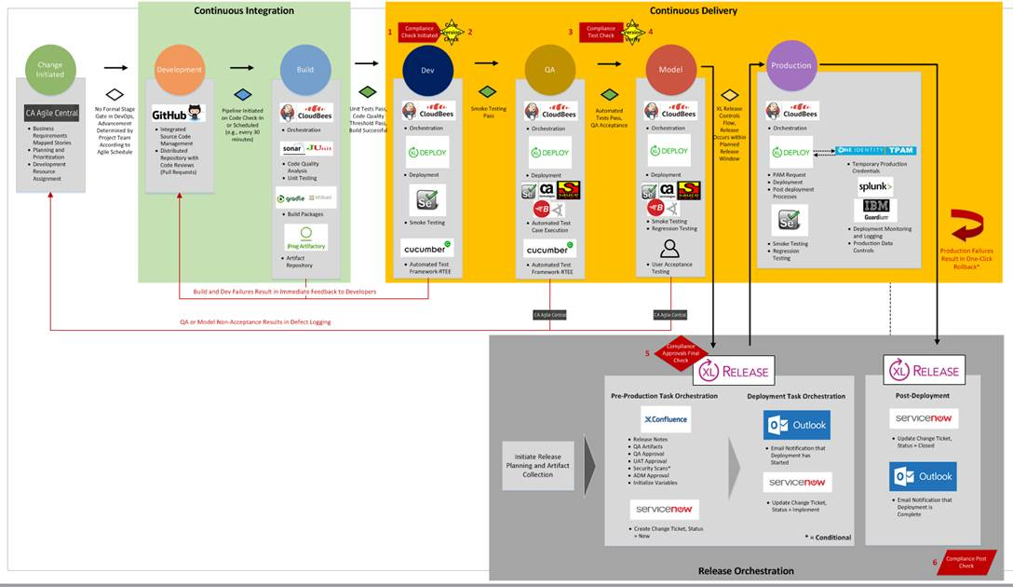
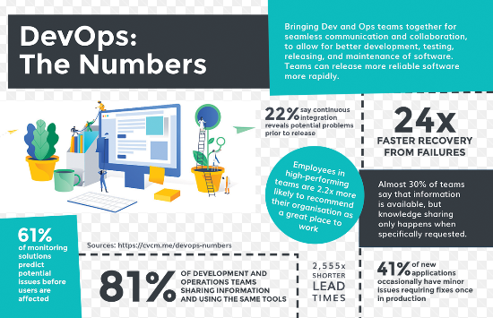
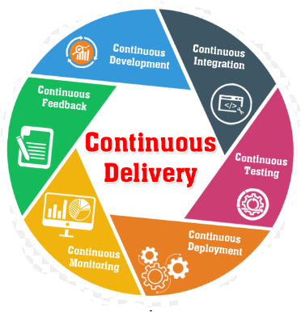
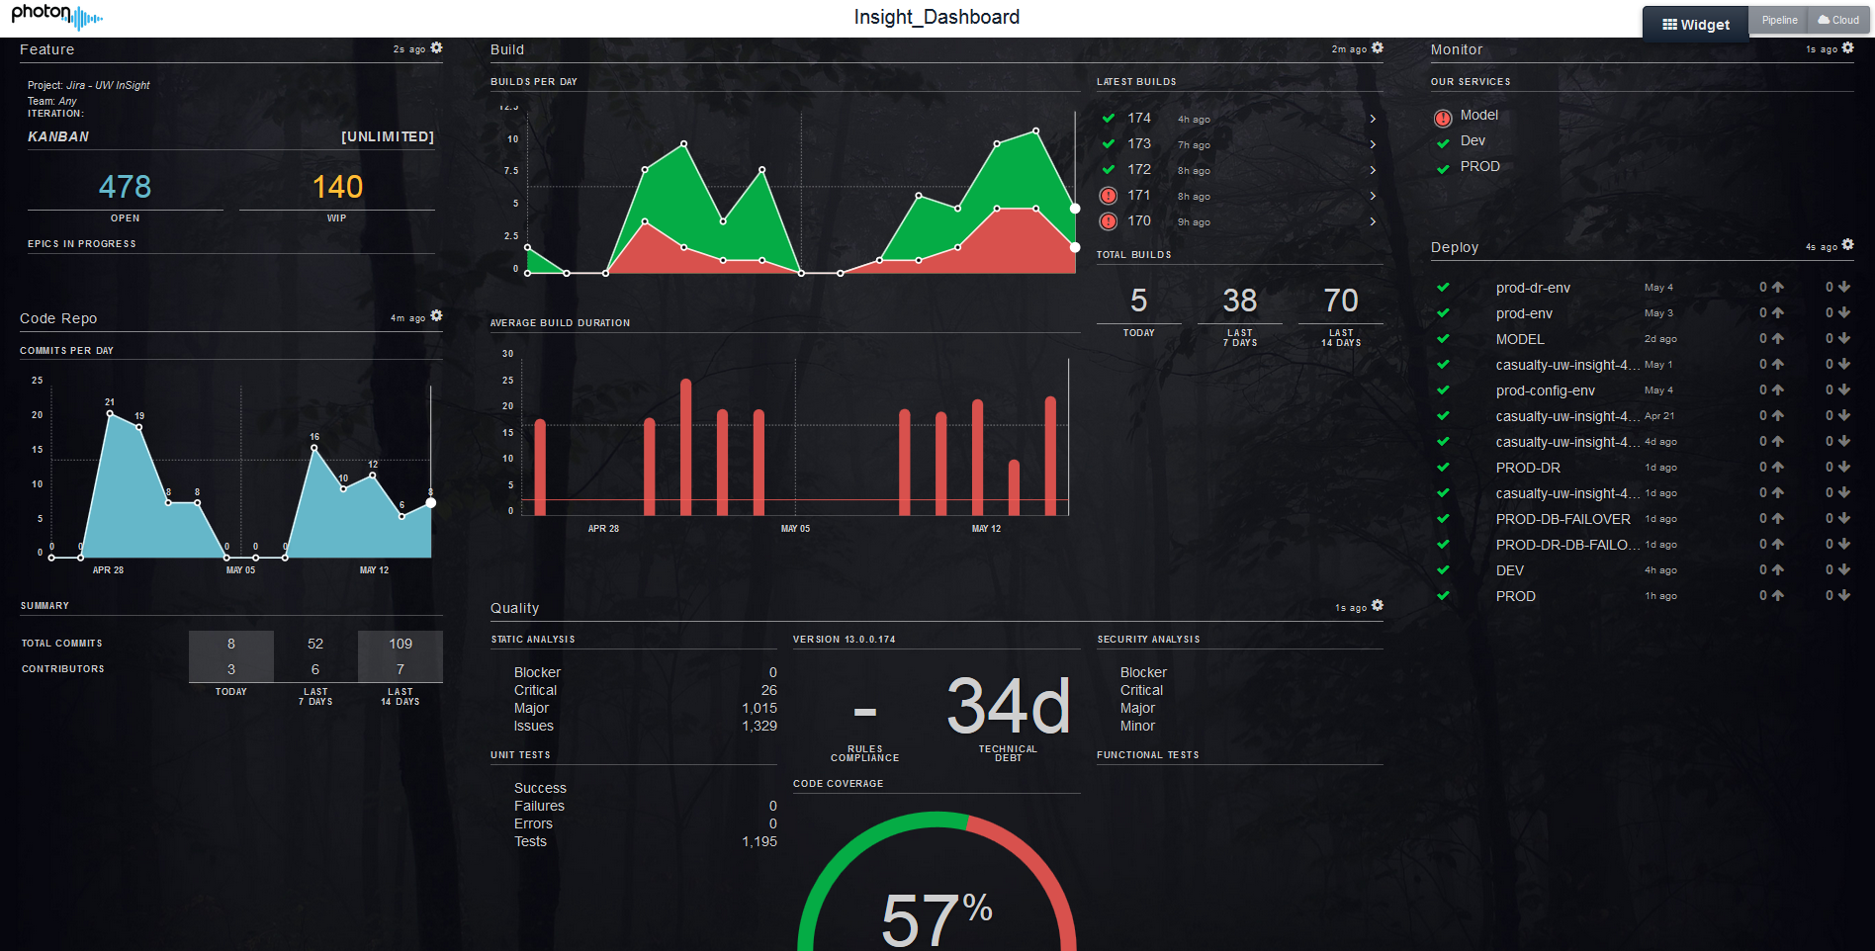
DevOps Engineering & Continuous Delivery
Who?
How?
Wha
t
?
DevOps is a set of practices and cultural values that help organizations improve their software release cycles, software quality, security, and ability to get rapid feedback on product development and achieve business outcomes.
DevOps along with Agile practices enable Continuous Delivery
Advisory Services
DevOps Coaching
Role Based Training
Bootcamps
Cloud Architecture Review
Containerization Strategy
Hosting Strategy
CI/CD Pipeline
Core Engineering Services
Pattern based CI/CD
Self Service Deployment
Build Automation
One Click Deployment
Lifecycle Dashboard
Branching Strategy
Tool Select/Integration
Operating Model/ CD Behaviors
Transformation Services
IaaS/PaaS PO
PaaS Implementation
IaaS Enablement
CI/CD Pipeline Strategy
Release/Change Strategy
DevOps Shift
Transparency - Lifecycle Dashboard
Implementation Services
Value Streaming
CI/CD pipeline adoption
Cloud Enablement
Quality Gate Implements
Release Automation
Rally Access Mgmt.
Test Frameworks
Why?

Slide 5
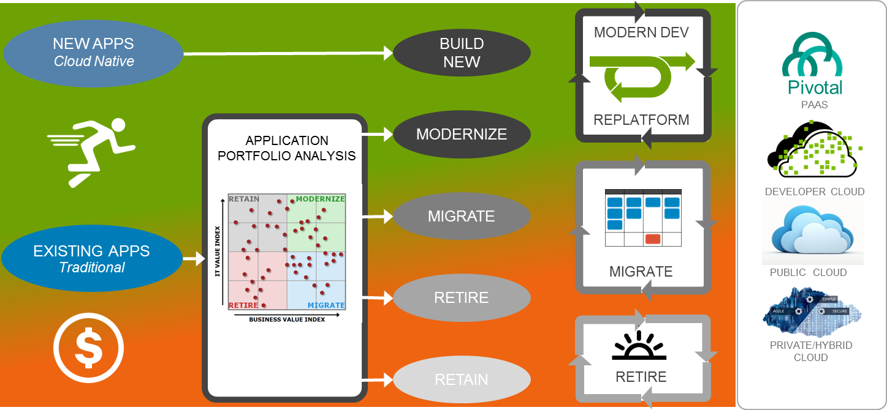
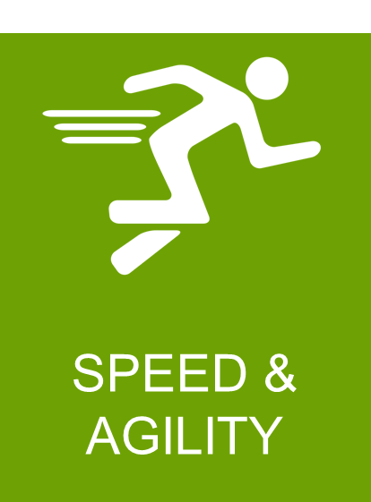
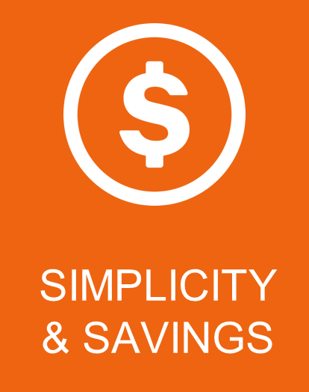
The Starting Point: High Level App Delivery Execution Strategy
CONTINUOUS DELIVERY PIPELINE
CYBER PORTAL
FNOL
MODE 2
MODE 1
UW INSIGHT
MN XPRESS
The solution will be to automate the entire lifecycle within the pipeline including App Delivery, Tech. Operations, Controls & Infrastructure
AGILE
CI/CD PIPELINE
PAAS/ CLOUD
MODE 2 ENABLERS
TEST AUTOMATION | OPERATIONS AUTOMATION

Slide 6
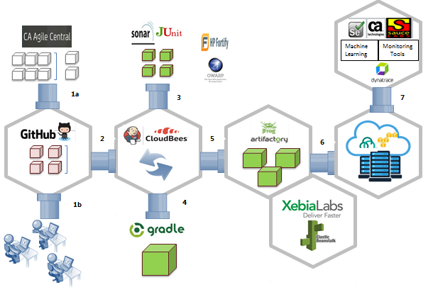
Building the CI/CD Pipeline : Skeletal Version
Continuous Testing
Work Item Management
Static and Unit Testing
Security Testing
Build Management
Source Code Management
Orchestration
Environment Management
CI
CD
Release Automation
Build Automation

Slide 7
Transparency: Lifecycle Dashboard

Slide 8
Applications/Programs Onboarded to CI/CD
CI/CD Pipelines Onboarding
Property
Multi-National
Financial Lines
EMEA
LATAM
On-boarded: 11
On-boarded: 4
On-boarded: 2
On-boarded: 2
In-Progress
Casualty
Claims
UI/UX
Common Services
Data Services
On-boarded: 3
On-boarded: 8
On-boarded: 1
On-boarded: 79
On-boarded: 4
TECHNOLOGIES SUPPORTED
Angular JS
.Net Framework
Java
Pega
Duckcreek
Abinitio
Microstratergy*
Mulesoft
Netezza
Hadoop
Datastage
DDL/DML
SSIS
Qlikview
Autosys
Unity
Docker
Blockchain
AWS
Qliksense*
Supporting 100% Greenfield and ~90% Strategic Applications

Slide 9
Key Statistics
2016
2016
2016
2016
2016
2016
Multiple source mgmt tools
Unclear branching strategies
No Code Quality measures
Unknown tech debt
Tickets based manual process
No versioning for packages
All steps are manual
No public cloud support model
24 hrs SLA – QA, Model
Dev One deploy/day
All changes are “normal” changes
2 weeks code freeze
Source Management
Code
Quality
Build Automation
Pipeline
Orchestration
Deployments
Release/ Changes
No of Users: 302
No of Commit: 106003
No of Repos: 869
No of Scans: 20139
Fixed Findings: 595555
Build Breakers: 863
Zero touch build 19230
Versioning: Y
Auto Release notes: Y
Active pipelines: 691
Cloud pipes: 2
Day2 support: Y
Total Deploys: 17903
Avg Deploys/day: 137
~2018 forecast: 100K
Prd Deploy:1320
Std Change freeze: 1
Release WF: Y
2017/18
2017/18
2017/18
2017/18
2017/18
2017/18

Slide 10
THANK YOU

